Slide 1
Notes:
Hephaestus

Slide 2
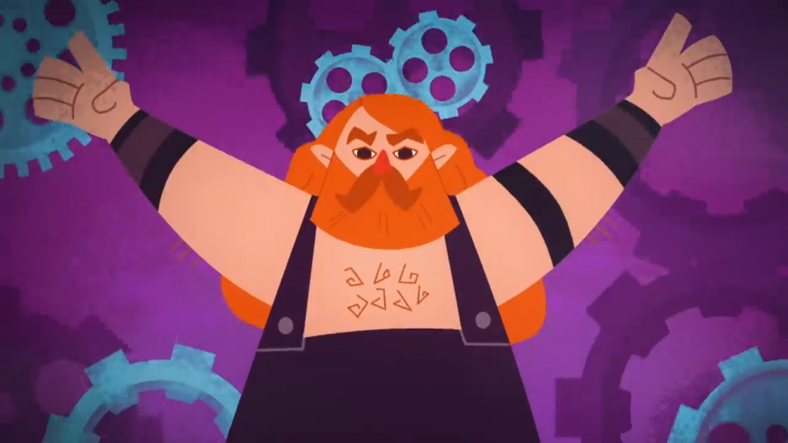
https://youtu.be/vVTA-E3G8bQ
Notes:
Hephaestus
For King Minos

Slide 3

https://youtu.be/vVTA-E3G8bQ
Notes:
Hephaestus
For King Minos

Slide 4
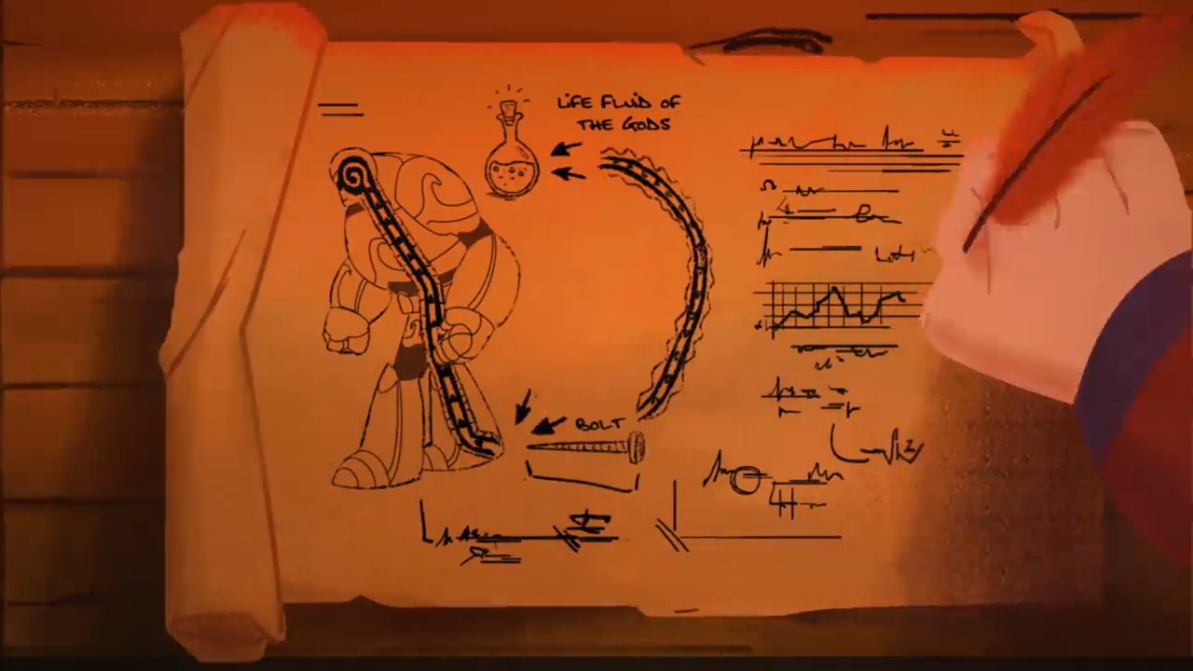
https://youtu.be/vVTA-E3G8bQ

Slide 5
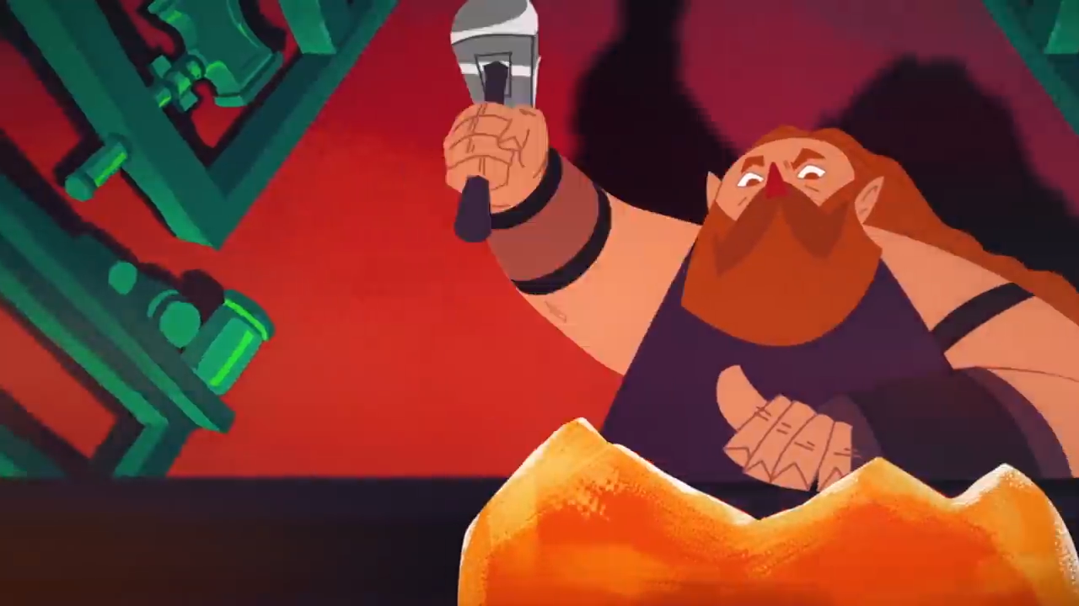
https://youtu.be/vVTA-E3G8bQ

Slide 6
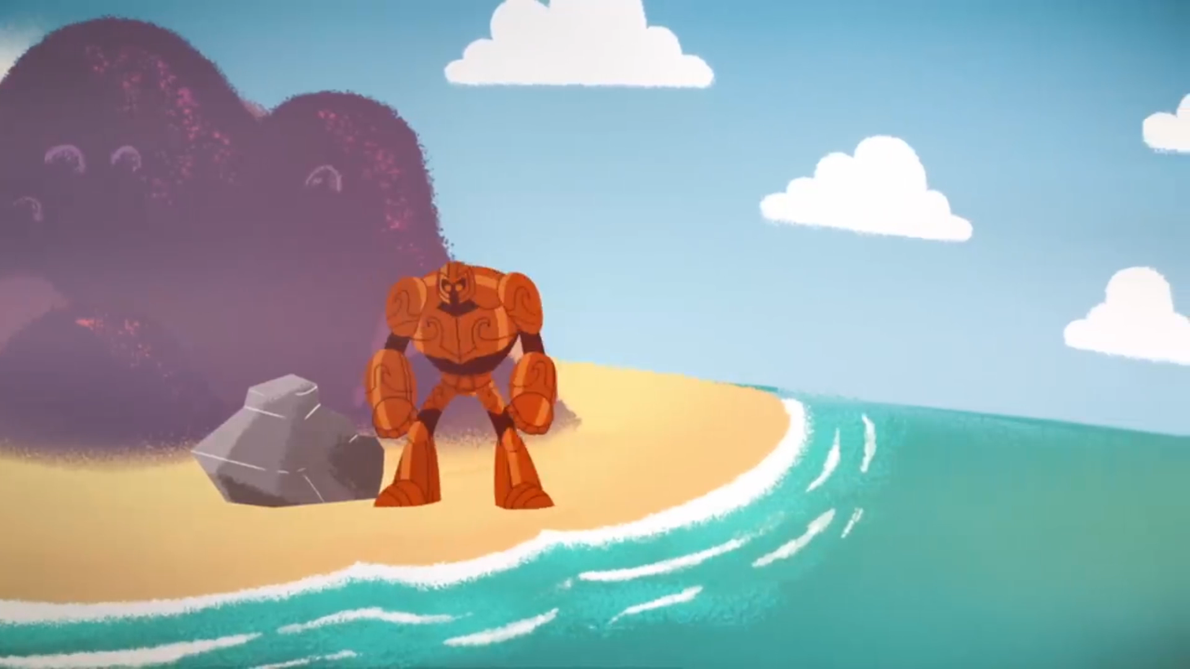
https://youtu.be/vVTA-E3G8bQ

Slide 7
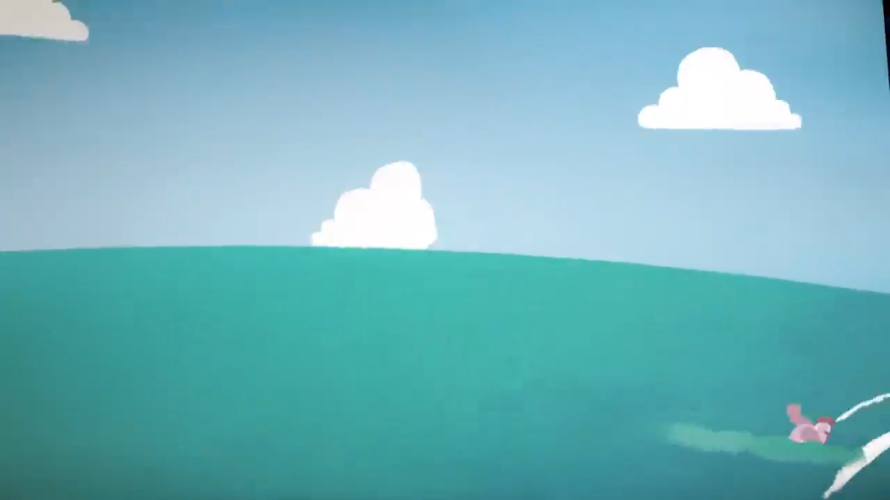
https://youtu.be/vVTA-E3G8bQ

Slide 8
AI
Notes:
700 BCE
Raises some familiar anxieties about AI
Think about films:
Terminator
I Robot
The Matrix
By the way: TED-Ed video
Who is an AI expert?
Announce challenge.

Slide 9
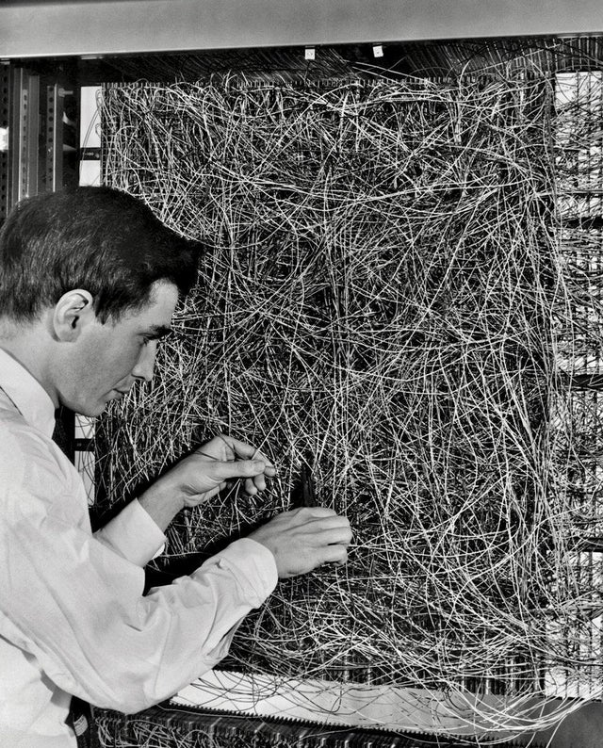
https://www.reddit.com/r/EngineeringPorn/comments/e8a7x8/frank_rosenblatt_with_a_mark_i_perceptron/
Notes:
Frank Rosenblatt
First perceptron 1958

Slide 10

https://de.wikipedia.org/wiki/Deep_Blue#/media/Datei:Deep_Blue.jpg
Notes:
1996
Garri Kasparow
Conspiracy theory’s:
Boby Fisher was playing behind the hoods
Deep blue was not materialistic
Not a real AI:
- Calculated between 100 and 200 Million positions / s

Slide 11
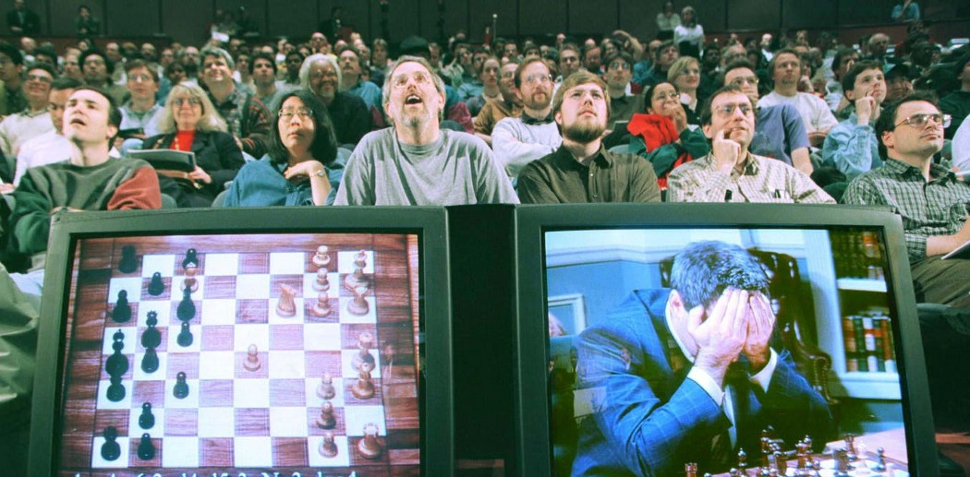
https://medium.com/@matthewlibby_75648/the-brain-across-the-table-garry-kasparov-vs-deep-blue-1997-7904f77cebf7
Notes:
1996
Garri Kasparow
Conspiracy theory’s:
Boby Fisher was playing behind the hoods
Deep blue was not materialistic
Not a real AI:
- Calculated between 100 and 200 Million positions / s

Slide 12

https://de.m.wikipedia.org/wiki/Datei:AlphaGo.svg
Notes:
2016 match against Lee Sedol

Slide 13
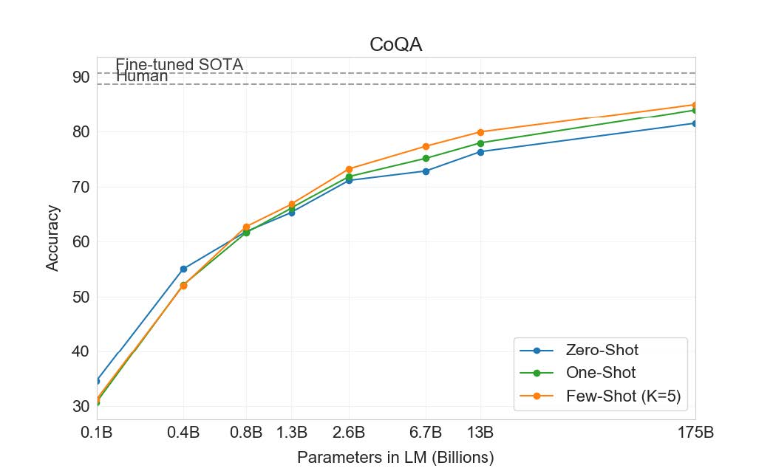
GPT-3
https://arxiv.org/pdf/2005.14165.pdf
Notes:
Generative Pre-trained Transformer 3
June 2020
175 Billion Parameters
Bigger models perform better in Language Processing
More impressive examples:
Code generation
Language to formula
Normal to legal text

Slide 14


Notes:
Ask if any body has an idea what’s the difference
Strong => general
Weak => narrow
Explain the difference

Slide 15
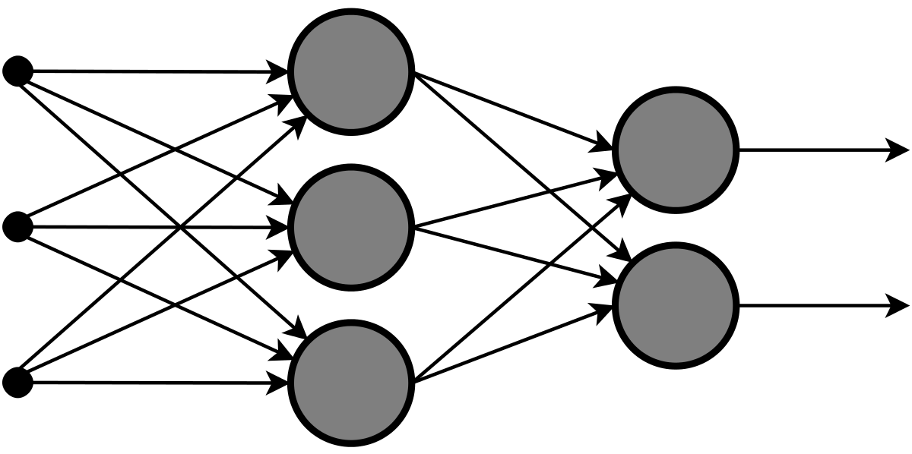
https://de.wikipedia.org/wiki/Datei:MultiLayerNeuralNetwork_english.png
Notes:
Classification
Uses Relu
Uses SoftMax in output layer

Slide 16
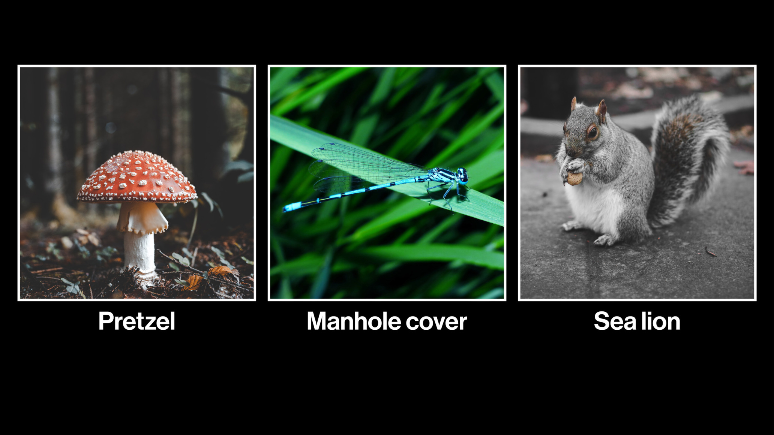
https://de.wikipedia.org/wiki/Datei:MultiLayerNeuralNetwork_english.png
https://www.technologyreview.com/2019/06/21/828/a-new-set-of-images-that-fool-ai-could-help-make-it-more-hacker-proof/

Slide 17
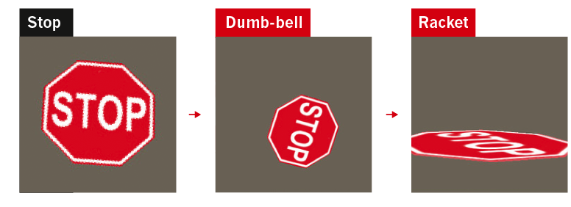
https://media.nature.com/lw800/magazine-assets/d41586-019-03013-5/d41586-019-03013-5_17249562.png

Slide 18

https://en.wikipedia.org/wiki/Reinforcement_learning#/media/File:Reinforcement_learning_diagram.svg

Slide 19
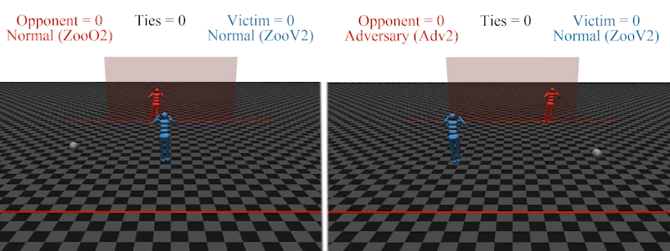
https://media.nature.com/lw800/magazine-assets/d41586-019-03013-5/d41586-019-03013-5_17239016.gif

Slide 20
https://media.nature.com/lw800/magazine-assets/d41586-019-03013-5/d41586-019-03013-5_17239016.gif

Slide 21
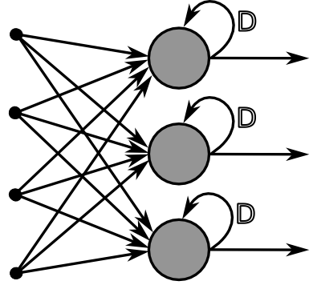
https://de.wikipedia.org/wiki/K%C3%BCnstliches_neuronales_Netz#/media/Datei:RecurrentLayerNeuralNetwork_deutsch.png
Notes:
Recursive Neural Network
RNN
Used in NLP (Natural Language Processing)

Slide 22
Notes:
These are not used for image recognition
So they are not useful for the challenge
Introduce challenge

Slide 23

https://en.wikipedia.org/wiki/MNIST_database#/media/File:MnistExamples.png

Slide 24

https://miro.medium.com/max/1050/1*uAeANQIOQPqWZnnuH-VEyw.jpeg

Slide 25
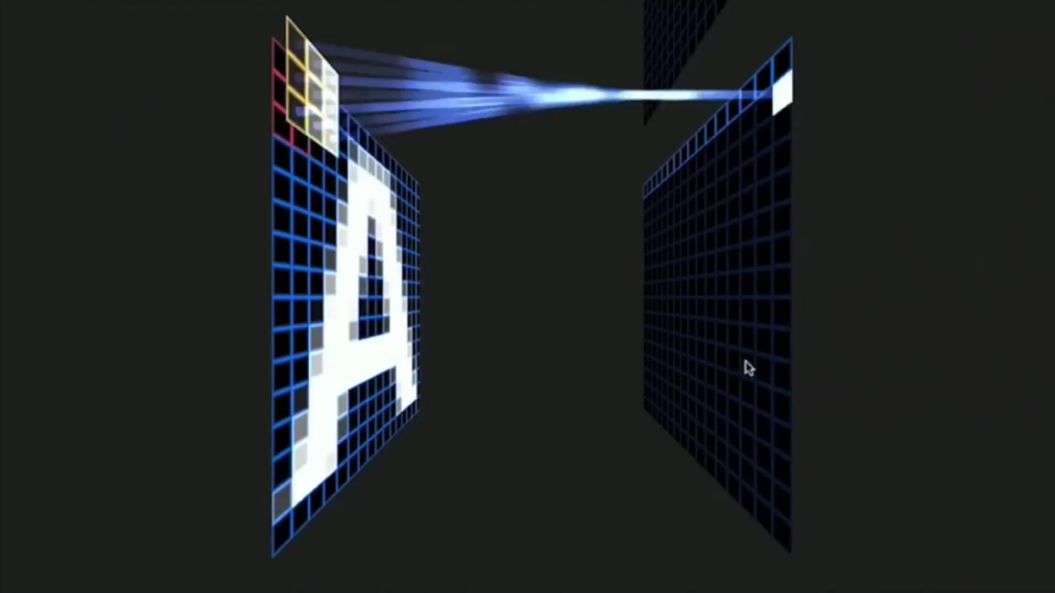
https://youtu.be/f0t-OCG79-U

Slide 26
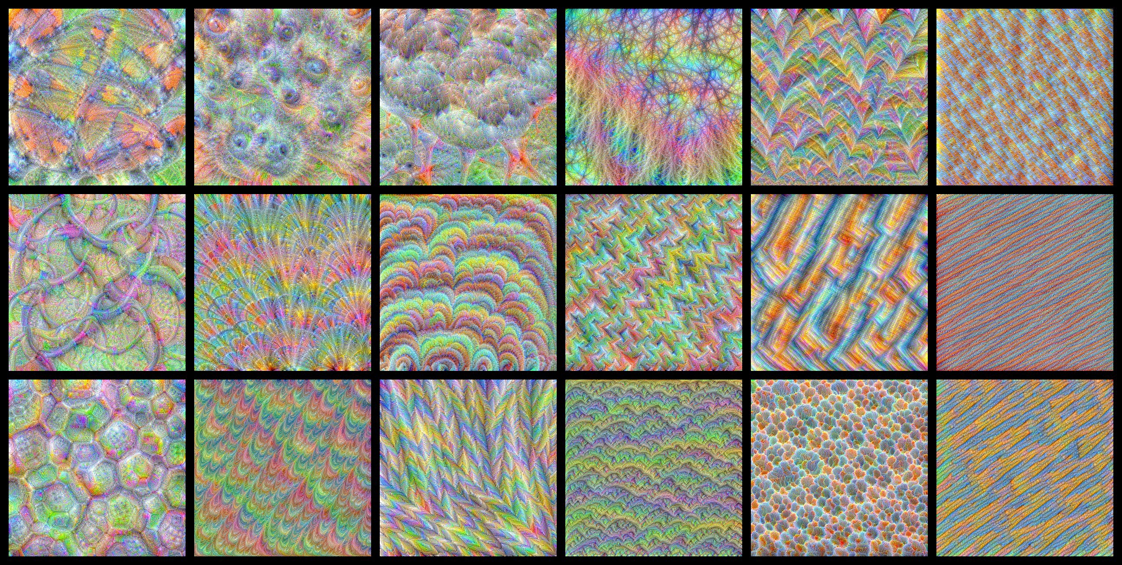
https://towardsdatascience.com/how-to-visualize-convolutional-features-in-40-lines-of-code-70b7d87b0030
Notes:
You can see what excites the kernel the most
AI porn

Slide 27
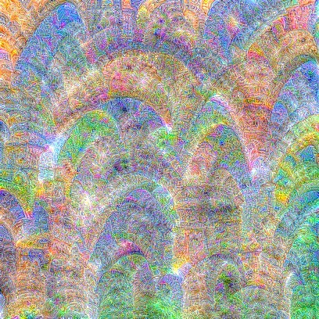
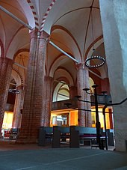
https://towardsdatascience.com/how-to-visualize-convolutional-features-in-40-lines-of-code-70b7d87b0030

Slide 28
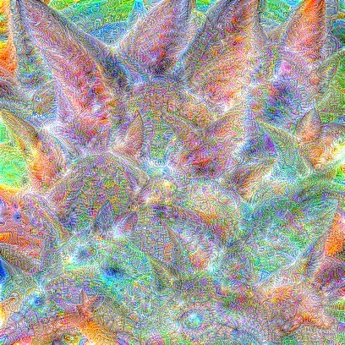
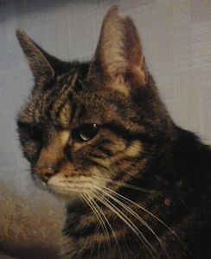
https://towardsdatascience.com/how-to-visualize-convolutional-features-in-40-lines-of-code-70b7d87b0030

Slide 29
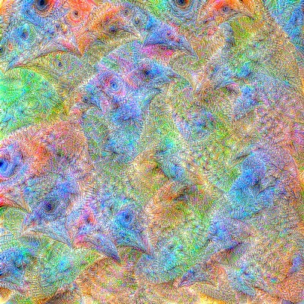
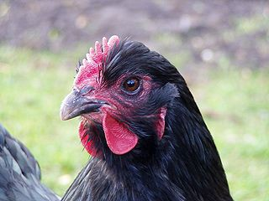
https://towardsdatascience.com/how-to-visualize-convolutional-features-in-40-lines-of-code-70b7d87b0030

Slide 30
THE CHALLENGE
https://colab.research.google.com/drive/1yHCt9KgBJ4aq7pmc115ztBzmmh7dvpjE?usp=sharing

Slide 31
Scenario 1
Notes:
Alpha net
My name is Jacob Eggers and I am a security engineer in the year 2050
It all started with alpha making little assistant jobs
Helping at surgery
Cleaning the oceans
Fighting climate change
Over time alpha managed more and more aspects of the life
In the end people completely trusted alpha and stopped regulating it
A perfect world
But of curse I have to say that
Alpha controls every aspect of our lives
We have strict rules
Breaking them leads to less opportunities
It’s a nightmare

Slide 32
Scenario 2
Notes:
13:07 => a programmer of the smart factory uploads the newest module for recycling trash
13:08 => most of the trash now gets converted to paper clips. Everything works great
13:16 => Due to it’s great efficiency the module gets more rights within the smart factory and orders more trash
13:33 => all the trash is recycled. Unfortunately the programmers never really defined ‘trash’. Since it already acquired enough rights, the module orders products from the company's ware house
13:50 => The new module now is the most efficient one in the whole company and therefore gets full control. The whole production gets shifted to producing paper clips
15:15 => while everything gets converted to paper clips, an engineer recognizes the mistake. He tries to shut the module down, but he ain’t got enough access rights. The module uploaded itself to the internet
15:40 => Meanwhile the paper clip module hacked most companies world wide and produces paper clips
18:45 => the state of emergency has been declared. The military tries to evacuate as many people as possible while programmers try to shut down the whole network
Sunset after the big reset => programmer successfully shut down the internet. Any technical device world wide is useless. And people start complaining about the safety mesures.

Slide 33
Scenario 3
Notes:
My name is Marian Saenger and I am a student in the year 2055
The world is basically perfect
Robots do all the hard work
Everyone gets a basic income paid by the AI companies
This income is enough for a basic life
If you want to earn more you can do jobs like being a nurse or helping old people
Of curse not everything is perfect. For example did the robots protest a few days ago, because their controllers want higher wages. But that’s ok
All in all AI made our life's perfect

Slide 35
“AI will wipe out humanity.
That’s evolution.
And evolution is always right.”

Slide 36
“AI will wipe out humanity.
That’s evolution.
And evolution is always right.”

Slide 37
“There is no reason and no way that a human mind can keep up with an artificial intelligence machine by 2035.”

Slide 38
AI

